Slide 1
Lesson 2 Activity 1
Sunny Meadows Investigation

Slide 2
Sunny Meadows
Notes:
Image of the bars instead of the pictures

Slide 3
Biomass
Biomass is the organic material in living things.
Biomass includes carbon, hydrogen, oxygen, nitrogen and other elements that make up living things.
If a pool of biomass increases, then the pool of organic carbon atoms increase too.
Notes:
Biomass is the weight of the entire organism (which includes carbon, hydrogen, oxygen, nitrogen, potassium, calcium and other elements).
Living things are about 20% carbon atoms (20% carbon atoms wet weight, 40-50% carbon atoms dry weight).
A carbon pool is just carbon atoms.

Slide 4
Biomass
Organic Carbon Pool
2
Carnivores organic carbon
Atmosphere
CO₂
4
Herbivores organic carbon
10
Producers organic carbon
Notes:
Here’s an example of how biomass and carbon pools are related.
Biomass is the weight of the entire organism (which includes carbon, hydrogen, oxygen, nitrogen, potassium, calcium and other elements).
Living things are about 20% carbon atoms (20% carbon atoms wet weight, 50% carbon atoms dry weight).
A carbon pool is just carbon atoms.

Slide 5
The Game
Sunny Meadows is a simulation game that allows you to choose the number of grass plants, rabbits, and foxes in an ecosystem. Then, you watch the grass, rabbits and foxes interact for 50 years. At the end of 50 years, you will be able to see how the biomass in grass, rabbits and foxes has changed.
Notes:
Insert slide of how to play the game

Slide 6
Directions for the Investigation
Go to the following website: http://puzzling.caret.cam.ac.uk/pregame.php?game=6
Select the age group you belong to: Ages 11-14 or Ages 15-18
Click “Play Game”.
Before playing the game, in “Choose View” select “Biomass” and in “Game Speed” select “4x.”
Use the “+” and “-“ keys to set initial numbers of grass, rabbits, and foxes, then click “Start” and watch what happens to the biomass until the game stops after 50 years.
Click “Reset” to try again with different initial numbers of grass, rabbits and foxes. Use the table on your worksheet to record your starting and final biomass for each trial. (Do as many trials as you have time for up to 10 trials.)
Notes:
Insert slide of how to play the game

Slide 7
What initial numbers of grass, rabbits and foxes will produce the largest fox biomass?

Slide 8
Pay close attention to: 1. Does the size of the biomass of grass, rabbits and foxes change over time? Why? 2. The biomass size of grass, rabbits and foxes compared to each other. What patterns do you see?

Slide 9
Class Averages
After completing worksheet questions 1-3
Record your “best attempt” (most numbers of foxes) in the class data spreadsheet

Slide 10
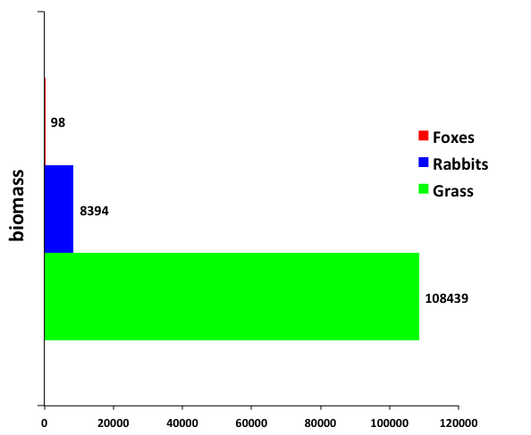
How does your class data compare to Mr. Chopp’s class data?

Slide 11
Why do you think this pattern exists in ecosystems?
Student ideas:

Slide 12
Answered Questions
Carbon atoms are associated with biomass (organic materials), and with inorganic carbon dioxide in ecosystems.
In Sunny Meadows, you noticed that the size of the carbon pools are always changing
So carbon atoms are moving in and out of each pool

Slide 13
An unanswered question:
We still don’t know how or why carbon atoms are moving in and out of carbon pools.

